Slide 1


Wearable Devices and Computer Vision (DGMD S-14)
Wednesday August 3rd 2021
S CCER FREE KICK CLASSIFIER
Ernst Barbier
Prince John Okodua-Oboh
Raul Pulido
Introduction
System Architecture
Conclusion & Future Work
Combined Data Results
Demo
DSP
Classifier

Slide 2

Introduction
PROBLEM
GOAL
HOW?
The game of soccer involves several skills including free kick accuracy. Statistical analysis reveals that only 75% of taken free kicks gets converted into a goal.
Our goal is to provide a system that helps soccer players improve free kick skills, ultimately increasing the chance to score a goal.
We leverage digital signal processing and machine learning for analyzing free kick shots.

Slide 3
System Architecture
1 - Data Acquisition
2 - Machine Learning
Smartphone sensor attached to kicking foot
Digital Signal Processing
Data recorded in Edge Impulse Studio
Classification with neural networks
Data labelled in 2 classes: GOOD KICK and BAD KICK
Testing

Slide 4
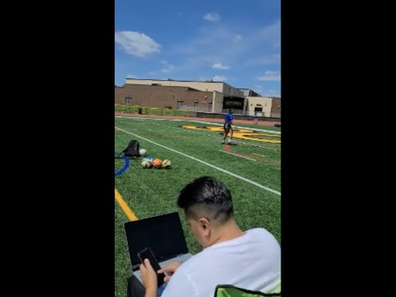
Data Acquisition Process

Slide 5
Combined Data
The three datasets were combined into one project.
We experimented with different parameters to generate the spectral features, but were unable to understand the impact that most of the parameters had on the dataset.
We looked at the differences the filter type would have on the dataset.

Slide 6
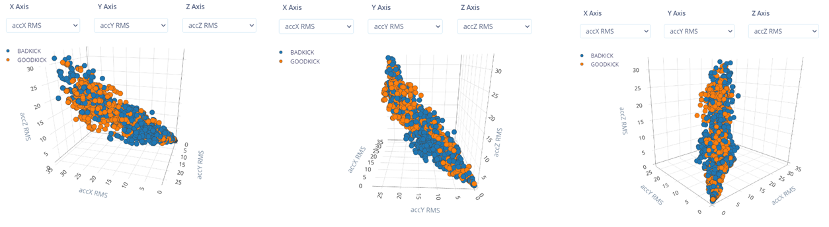
Combined Data-No Filter

Slide 7
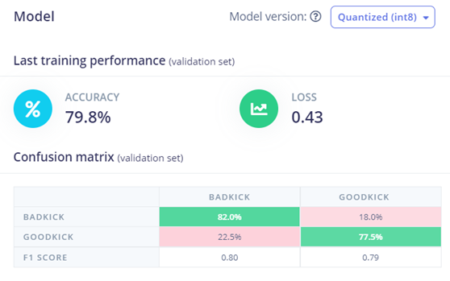
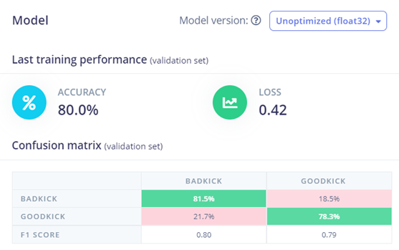
Combined Data-No Filter

Slide 8
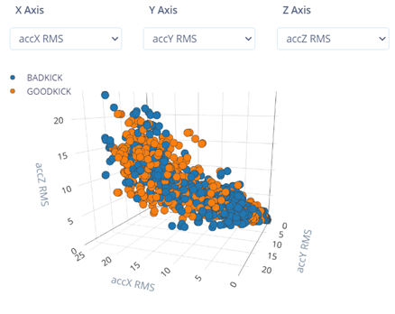
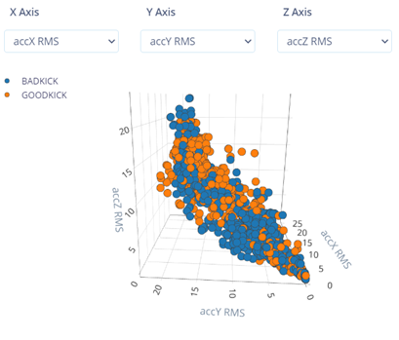
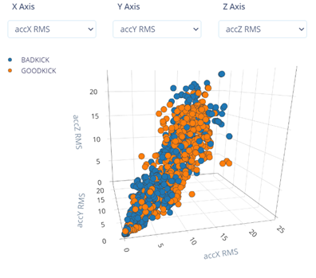
Combined Data-Low Filter

Slide 9
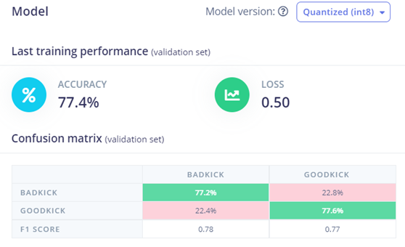
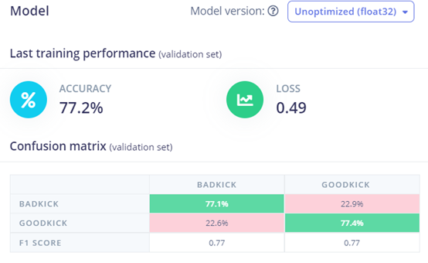
Combined Data-Low Filter

Slide 10
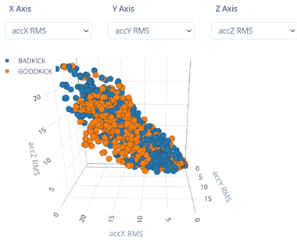
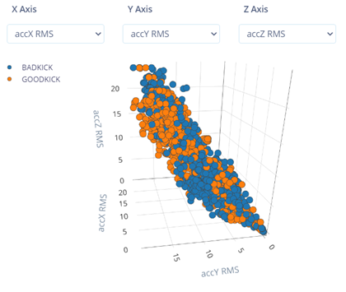
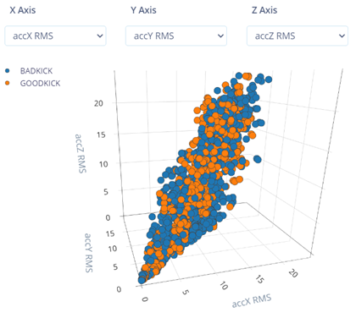
Combined Data-High Filter

Slide 11
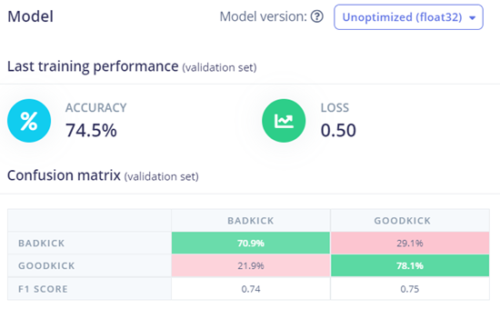
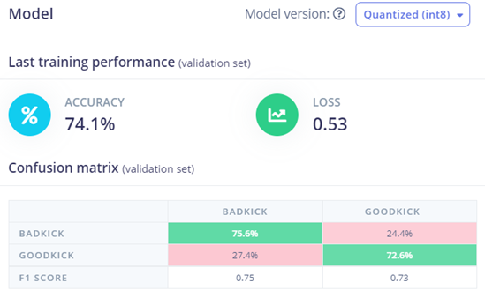
Combined Data-High Filter

Slide 12
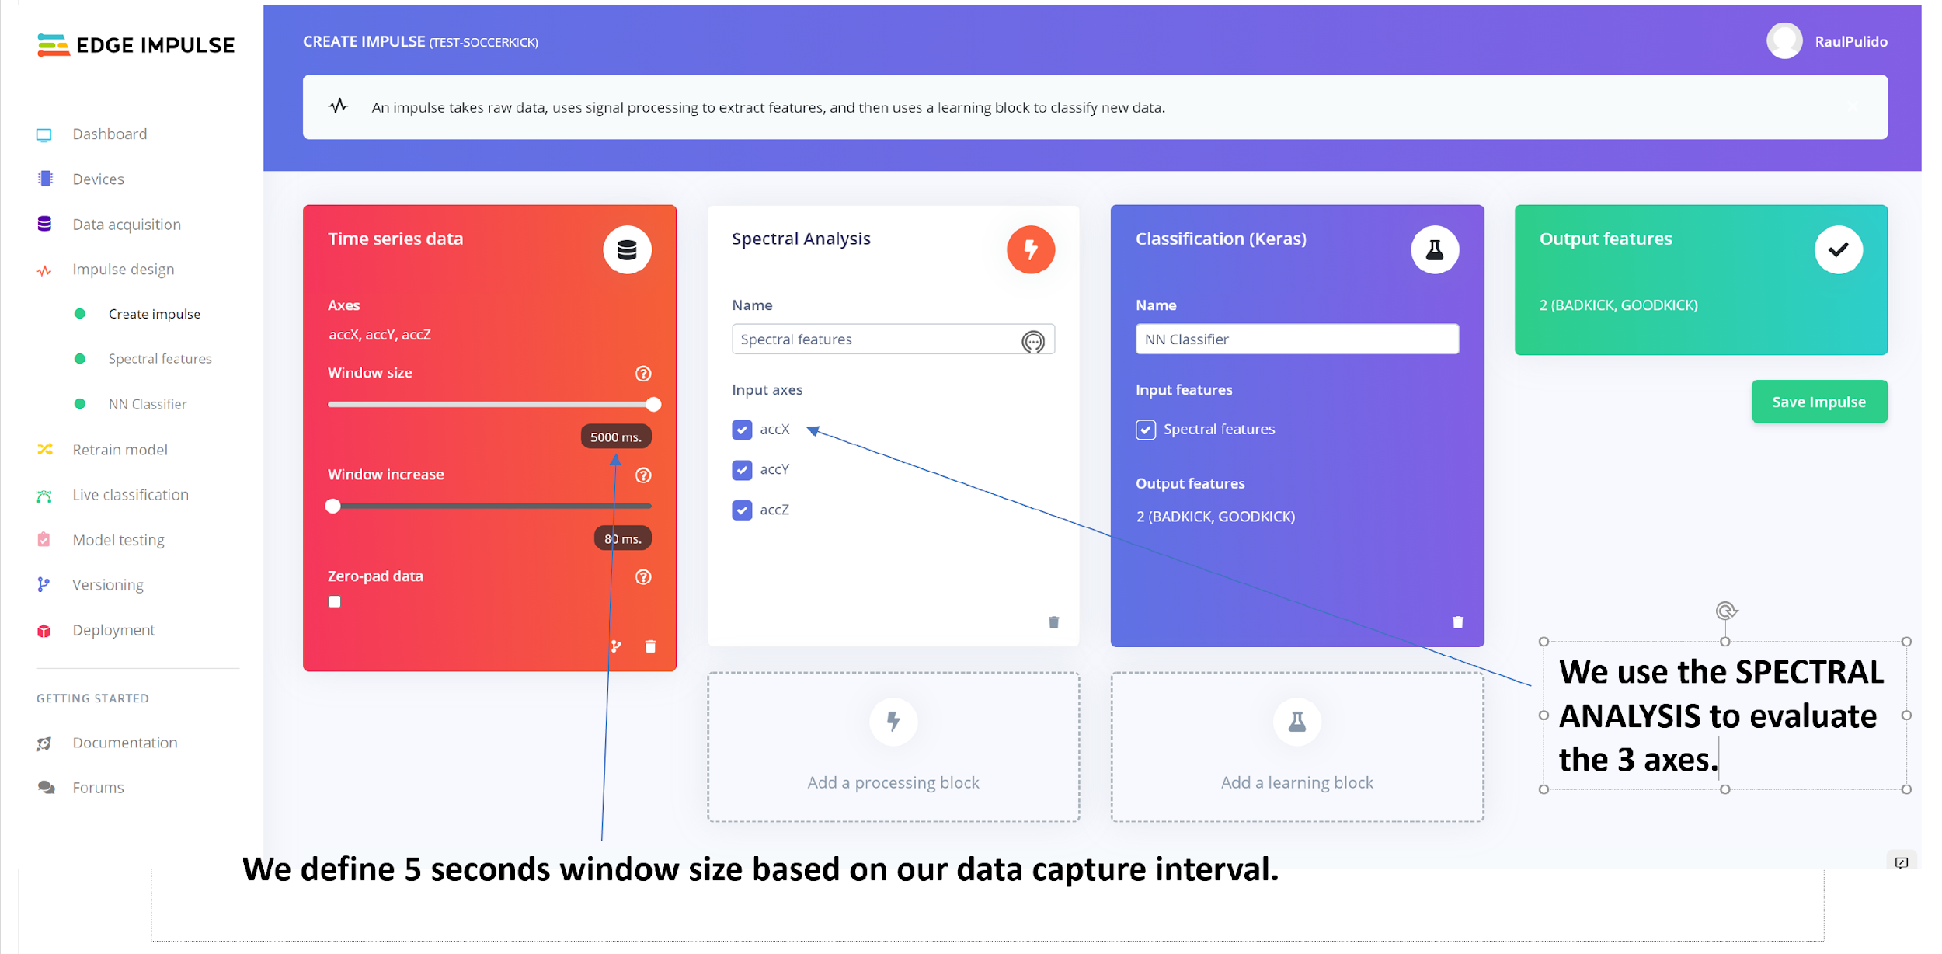

Slide 13
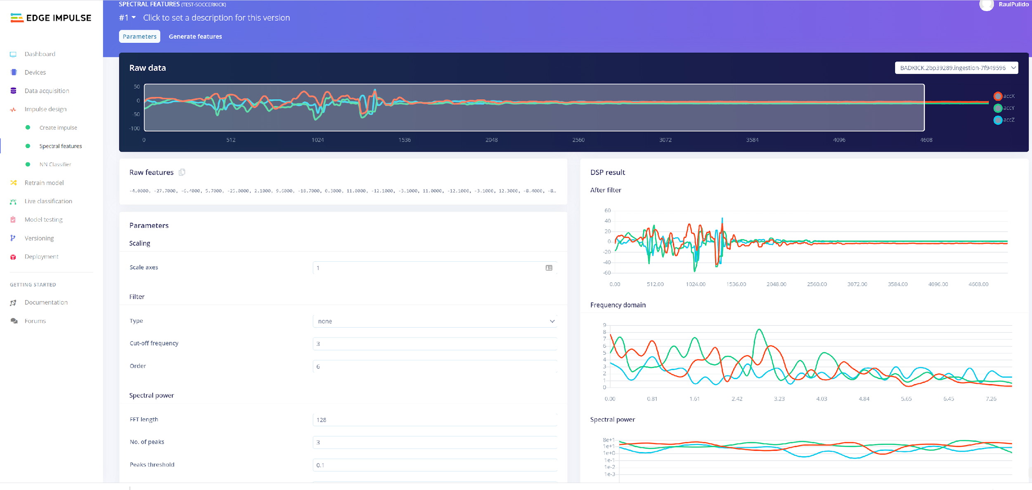
No Filter

Slide 14
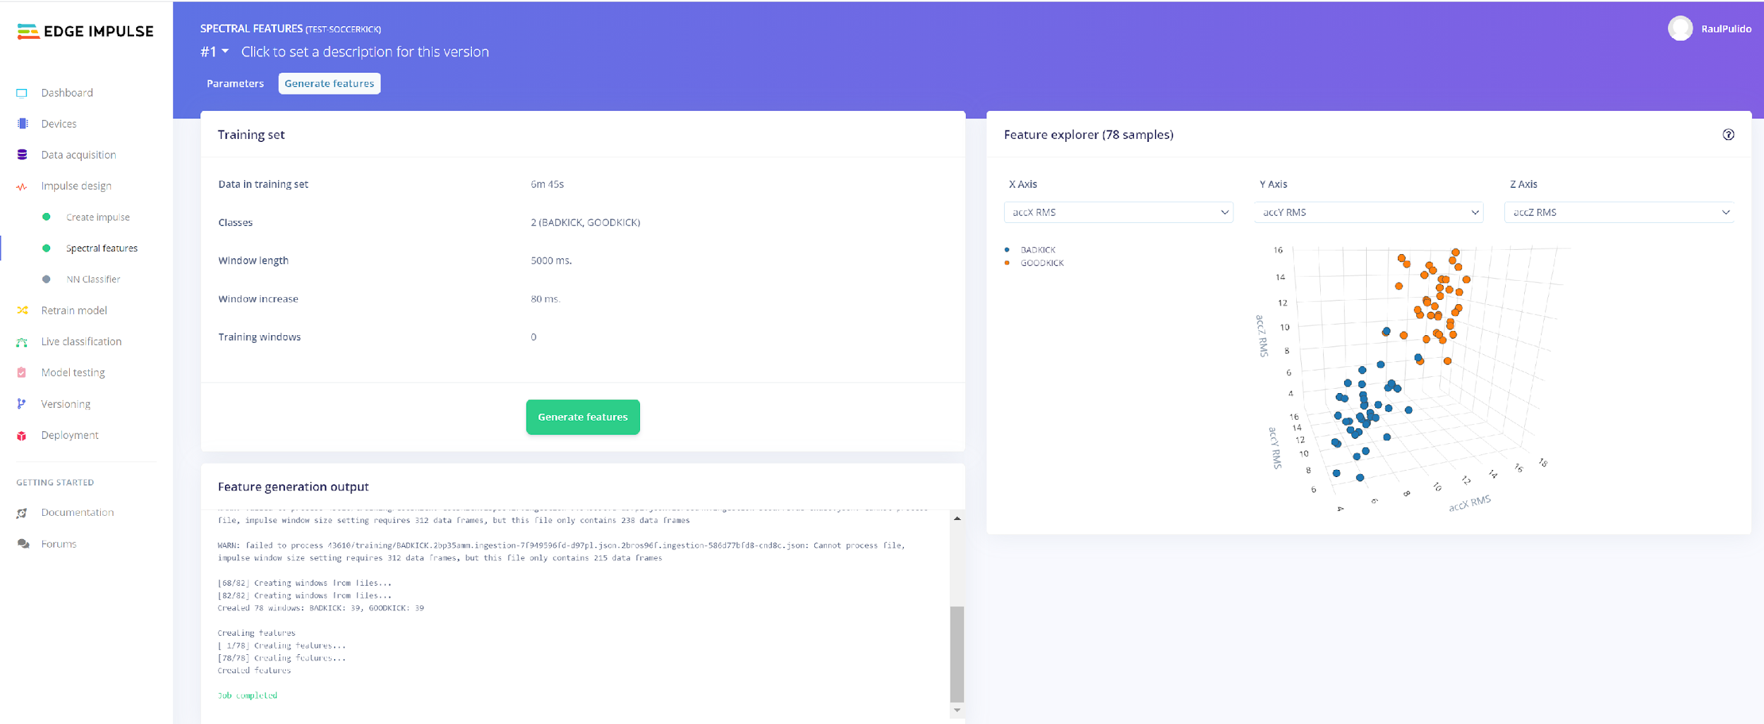
No Filter

Slide 15
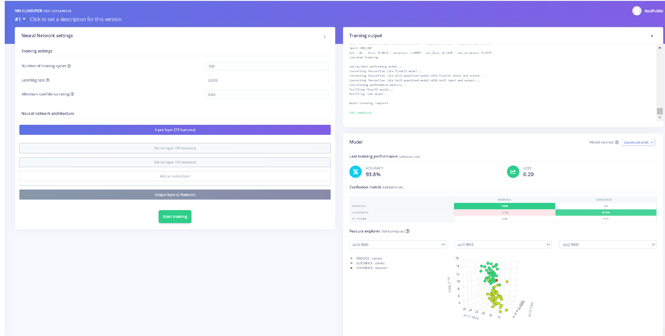
No Filter

Slide 16
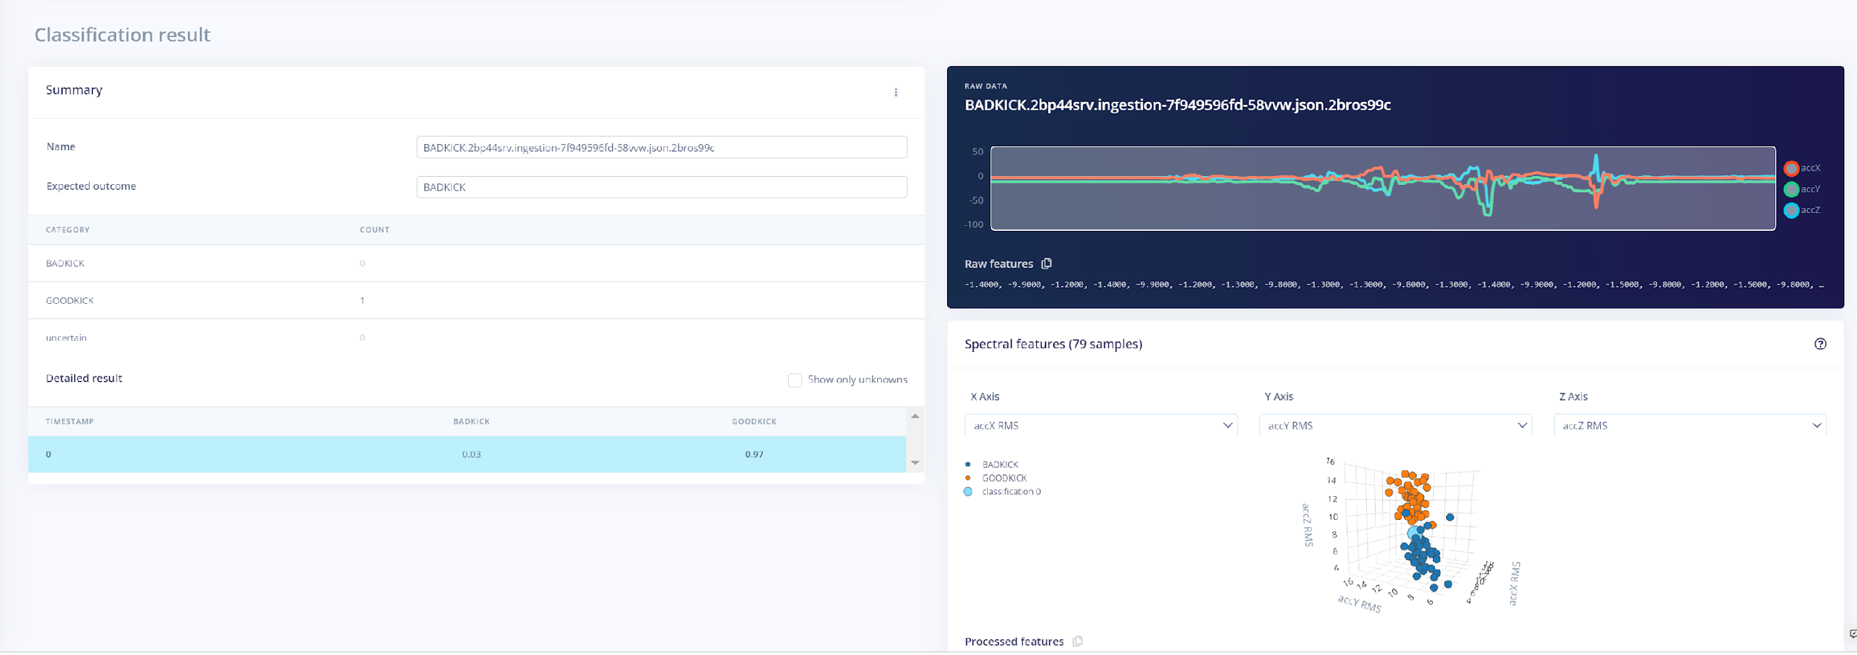
No Filter

Slide 17
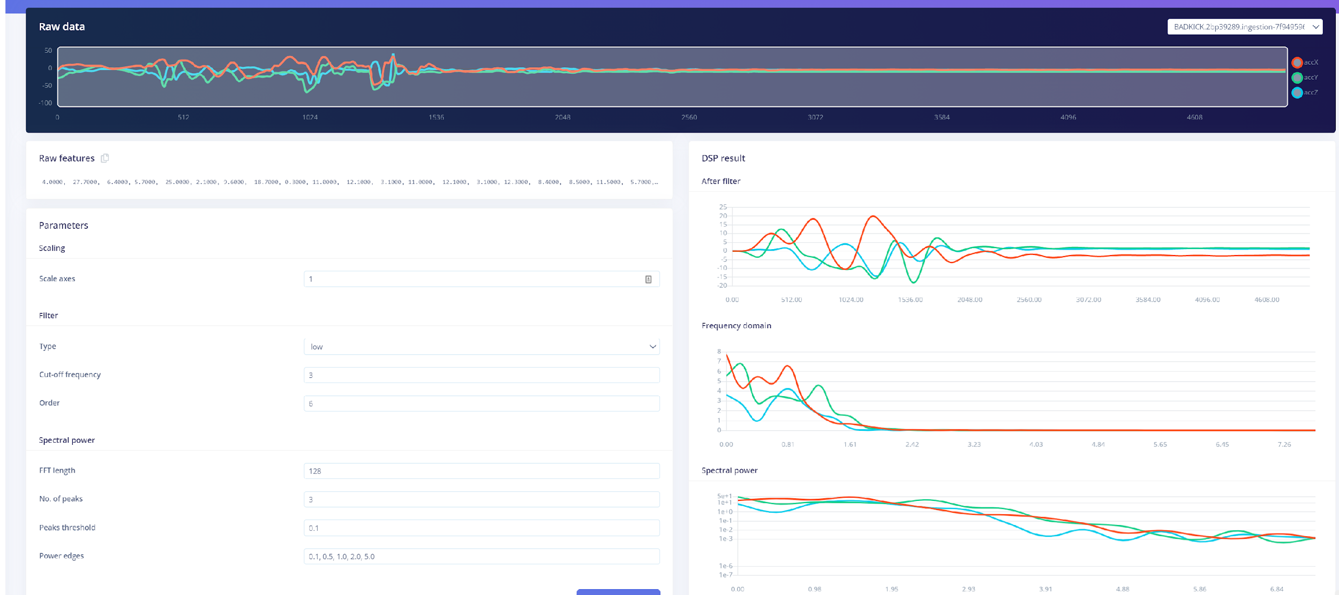
Low Filter

Slide 18
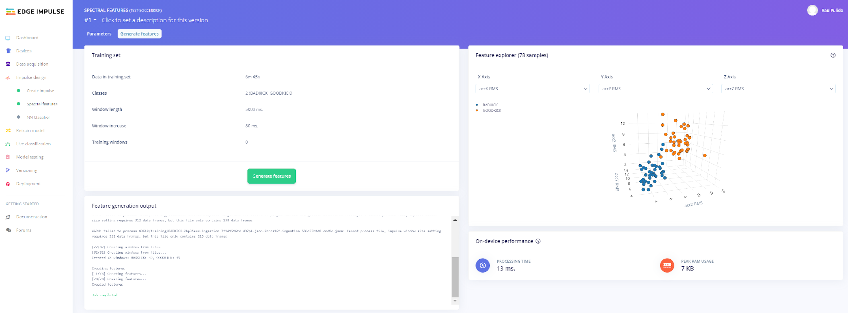
Low Filter

Slide 19
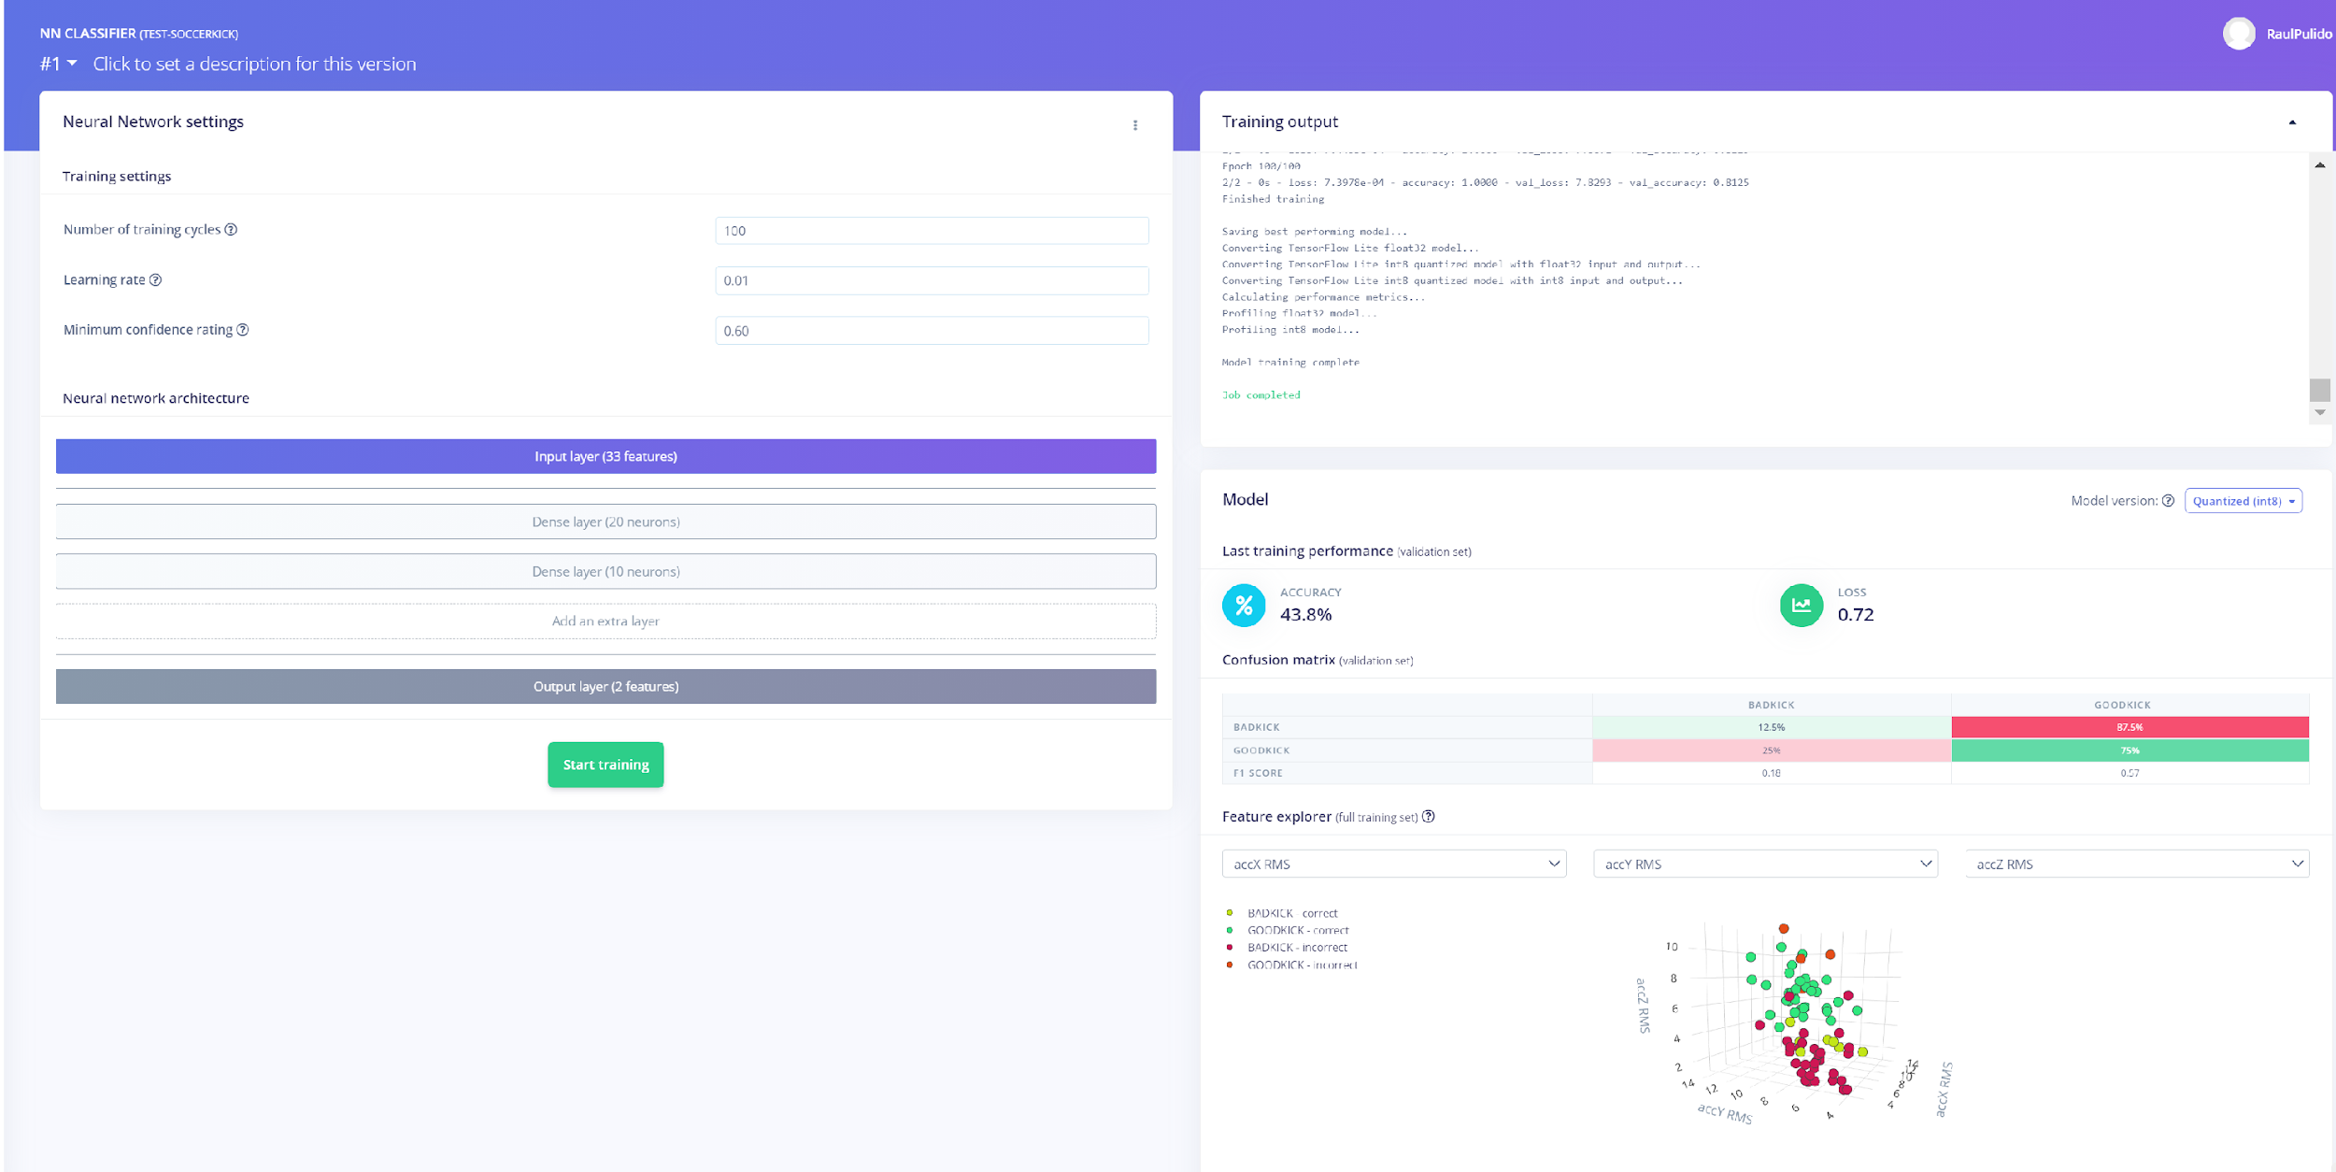
Low Filter

Slide 20
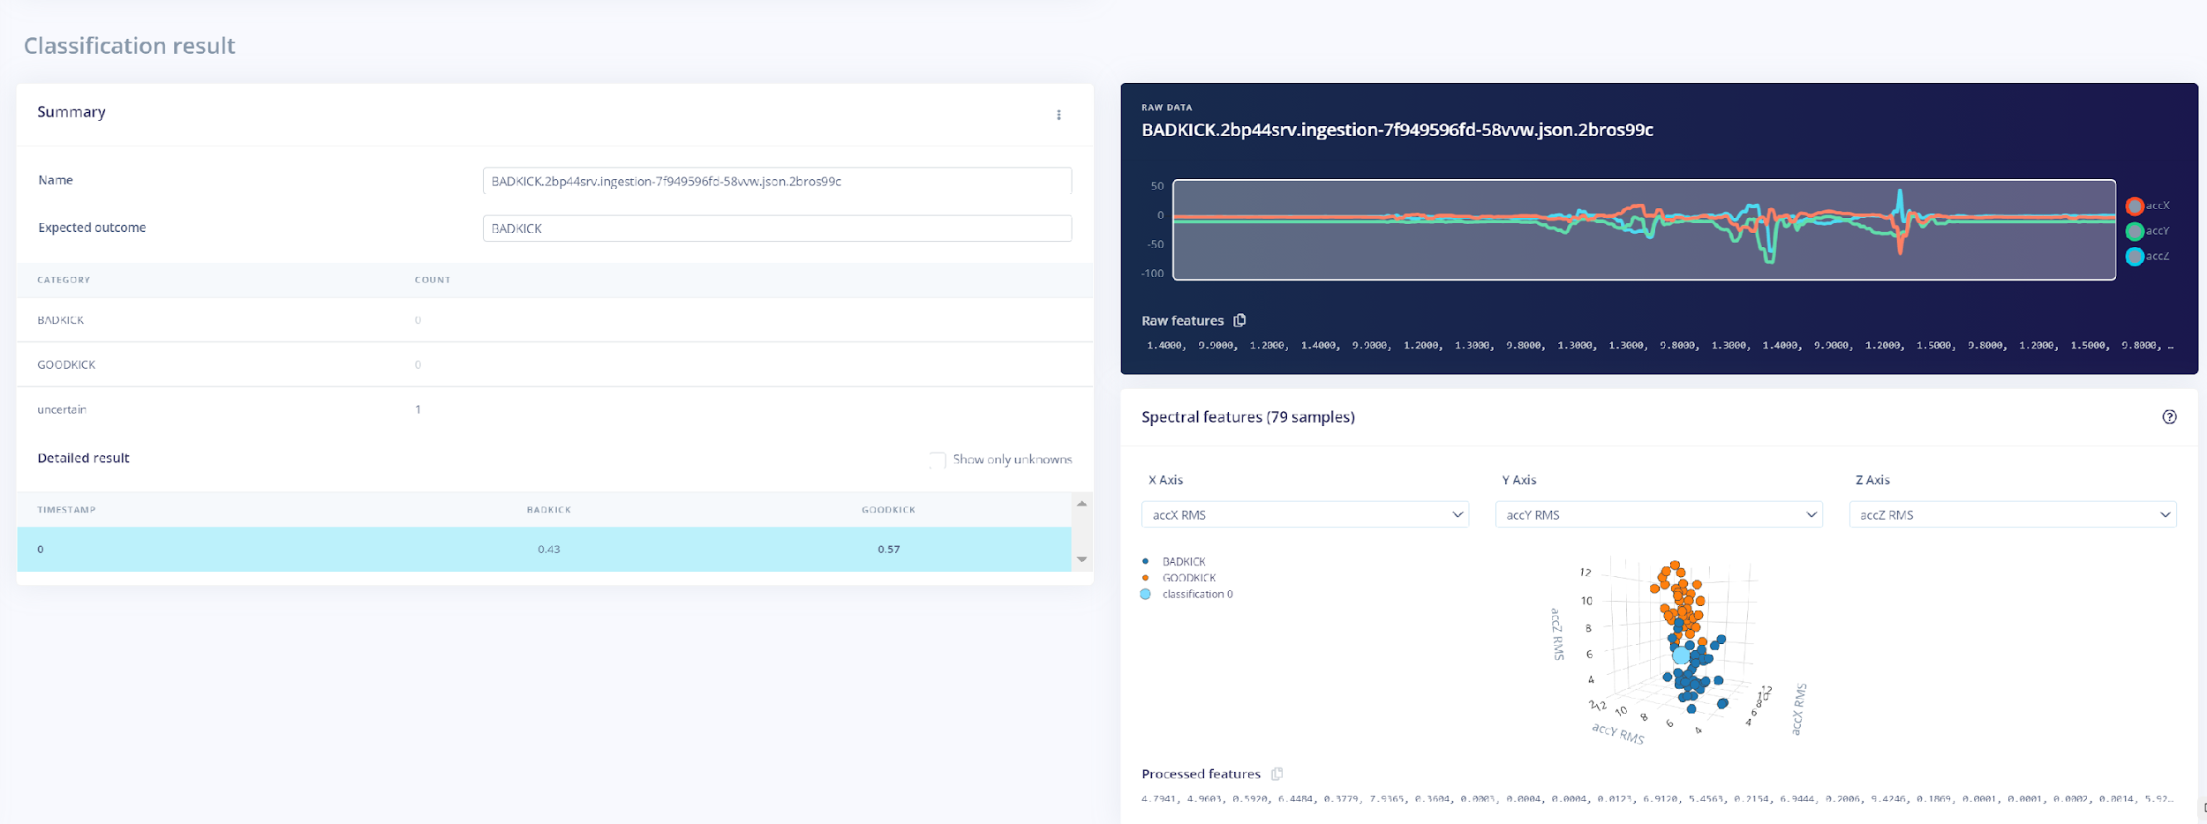
Low Filter

Slide 21
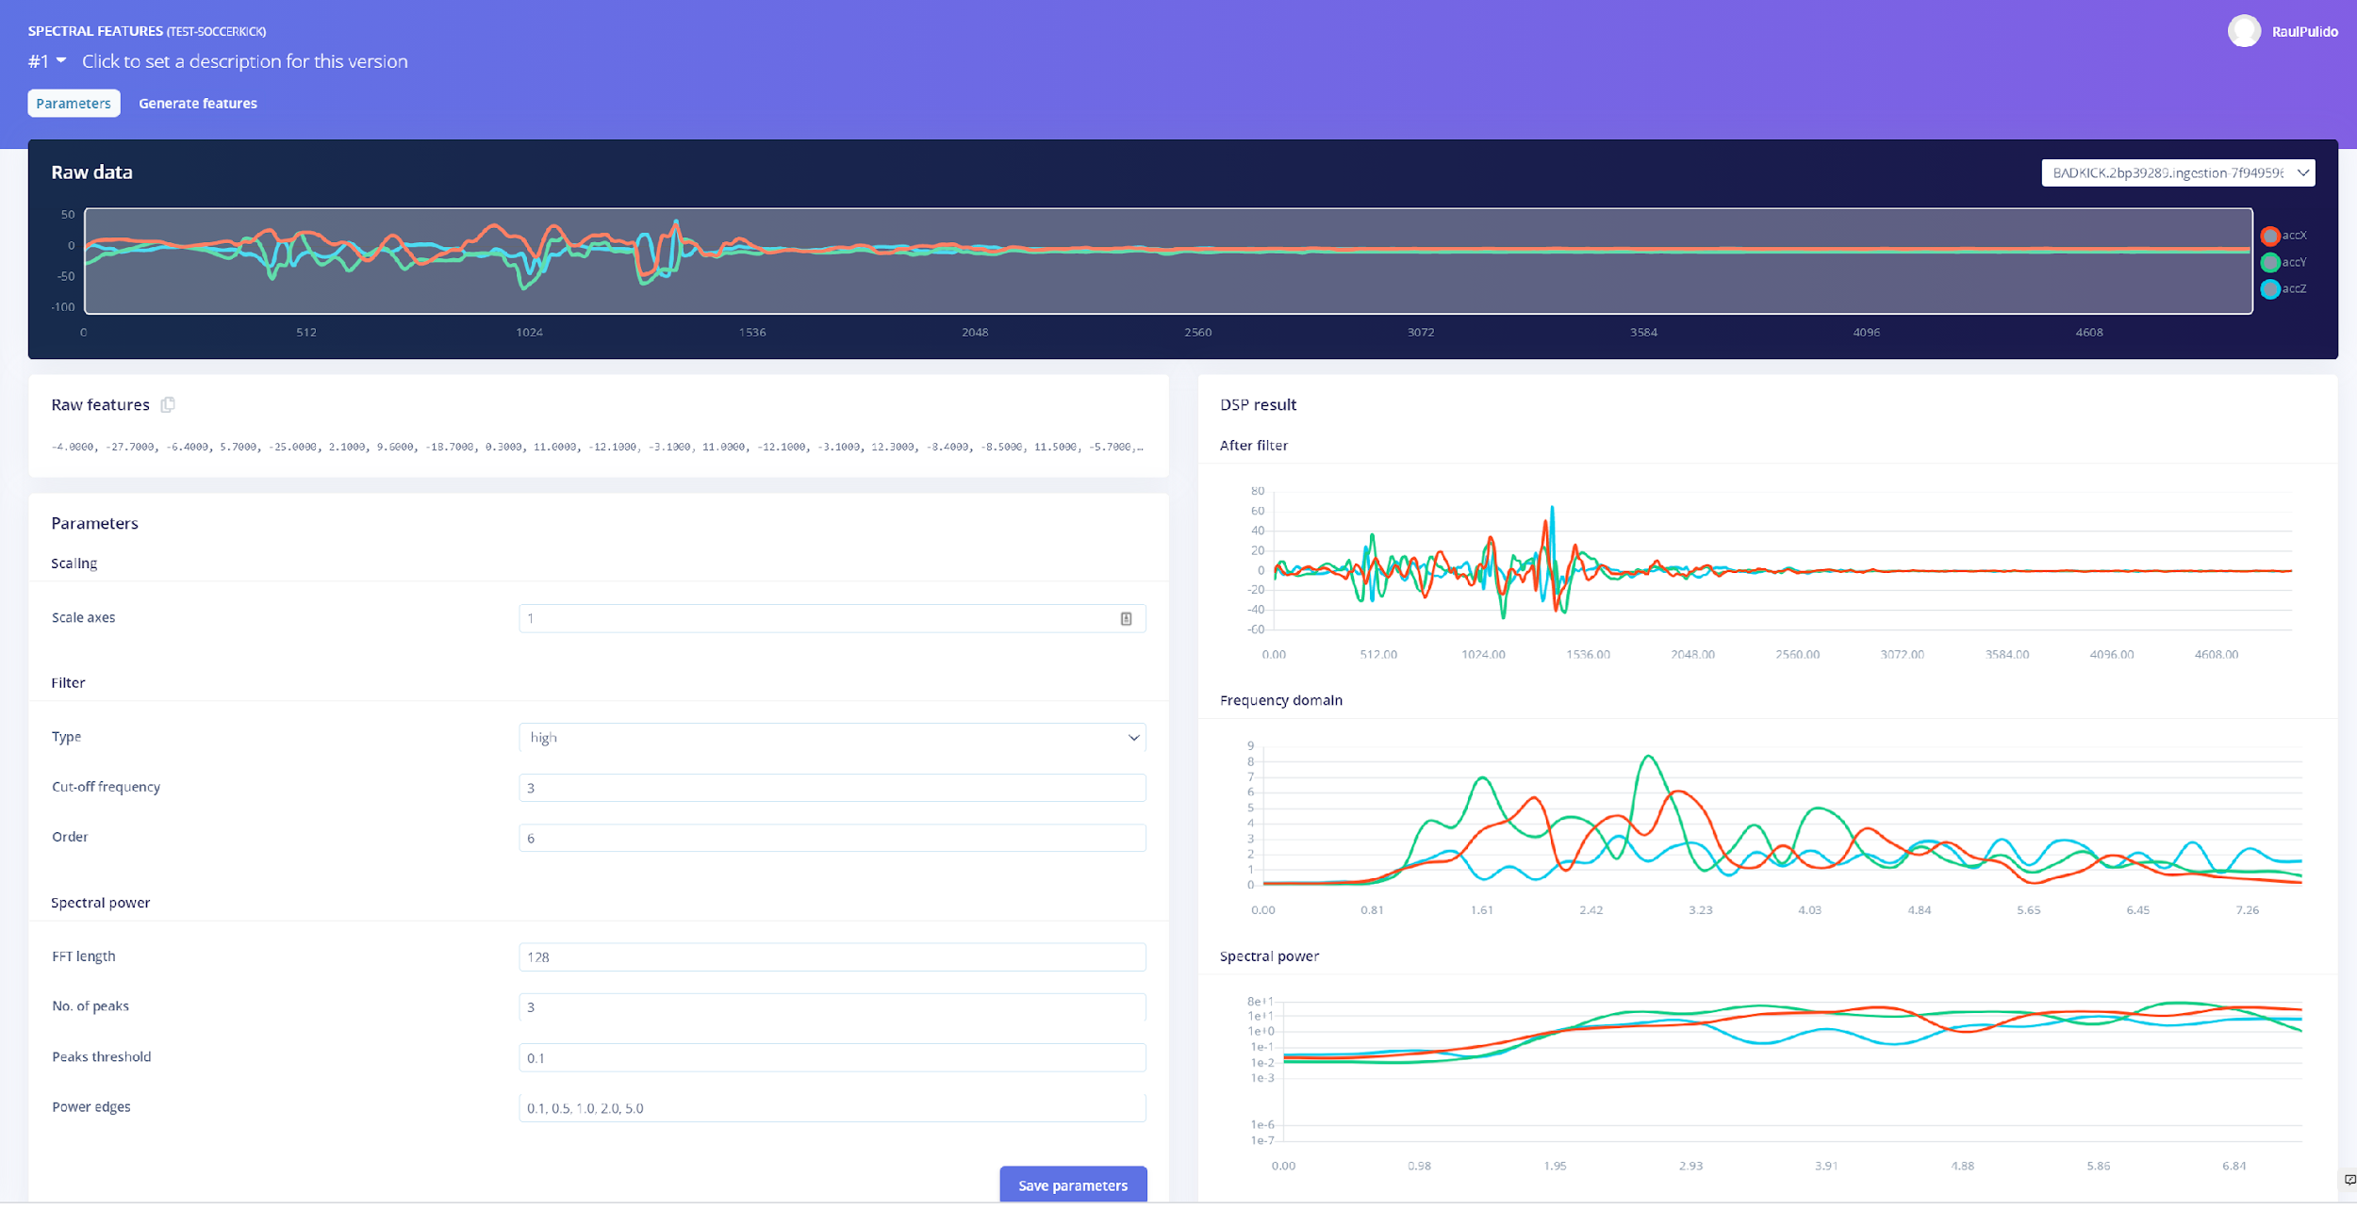
High Filter

Slide 22
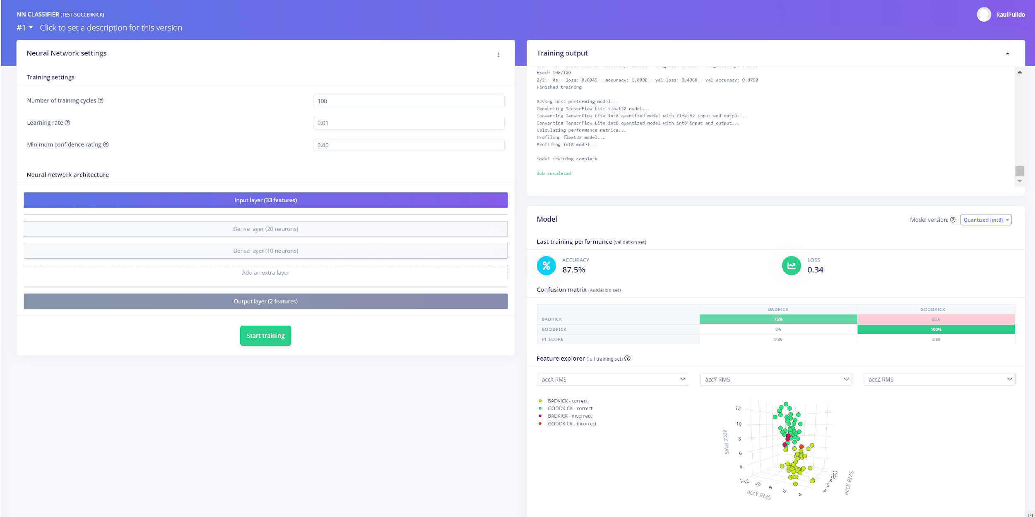
High Filter

Slide 23
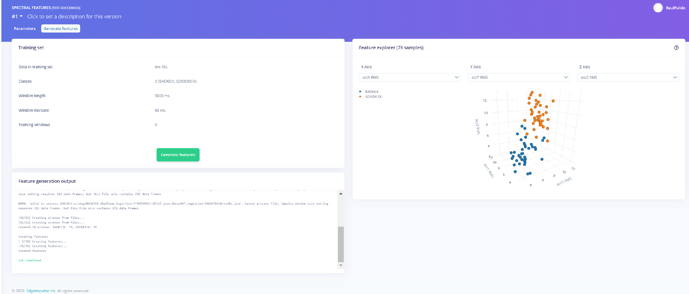
High Filter

Slide 24
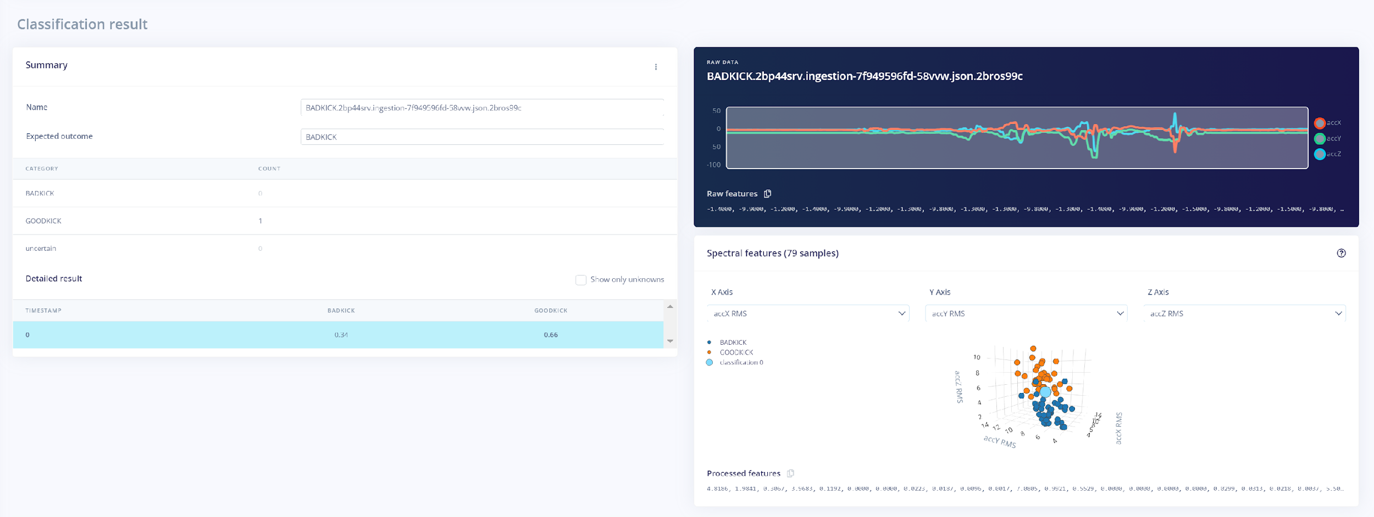
High Filter

Slide 25
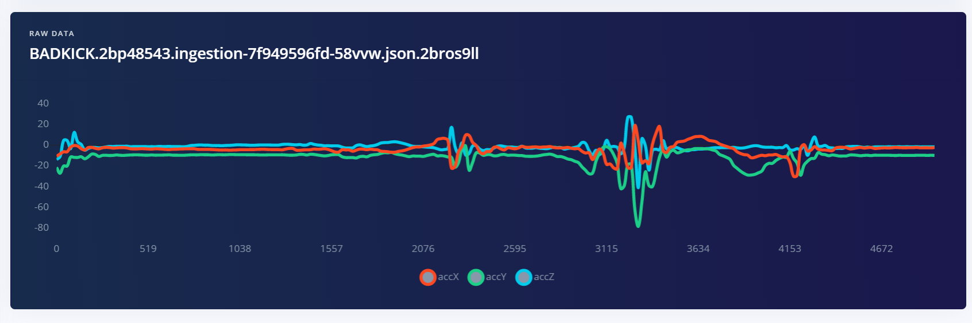
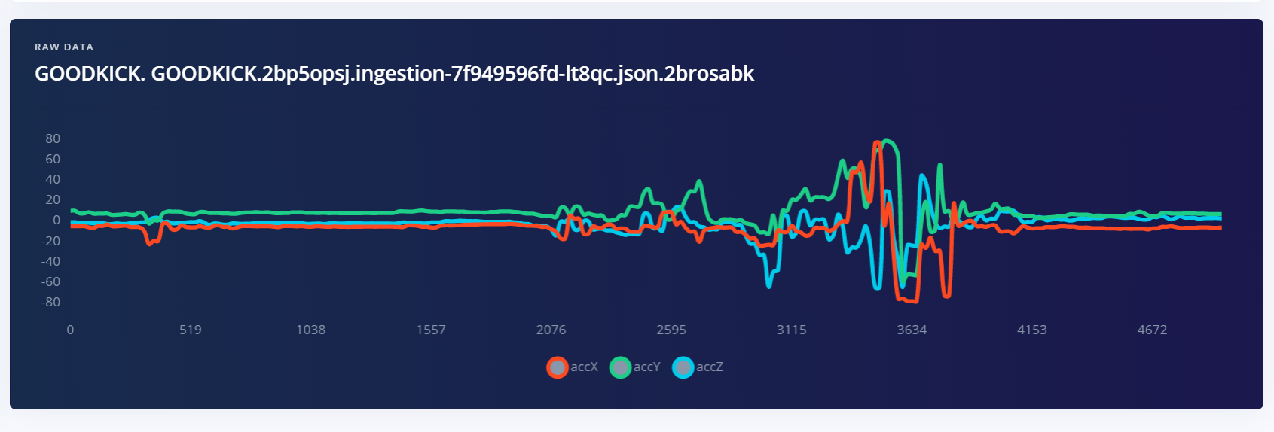
DESCRIPTIVE STATISTICS
BAD-KCK
Maxima under 40
GOOD-KICK
Maxima Over 80
MAX(GOOD-KICK) ALWAYS GREATER THAN MAX(BAD-KICK)

Slide 26
Conclusion & Future Work
Additional Features
Support for left-footed kick
Multiple goal size & distance
External factors (wind, etc.)
Graphical User Interface
User application

Slide 27
References
Situnayake, D. (2020, April 29). Make Deep Learning Models Run Fast on Embedded Hardware.
https://www.edgeimpulse.com/blog/make-deep-learning-models-run-fast-on-embedded-hardware
Jongboom, J. (2021, January 14). Visualizing ML Model Performance. https://www.edgeimpulse.com/blog/visualizing-ml-model-performance

